Slide 1
STAT3008/7001 Applied Statistics SLR= Simple Linear Regression
Ziren
u4975835@anu.edu.au
CBE 3.09
Thursday 10 am to 11 am

Slide 2
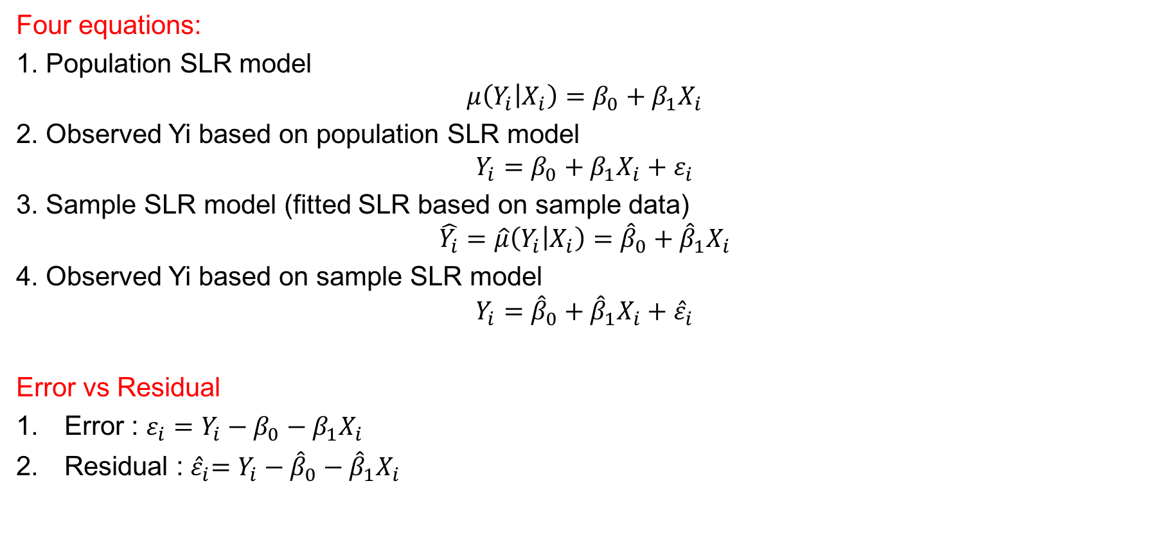
Revision - model
Four equations:
1. Population SLR model
$$μ\left(Y_{i} | X_{i}\right)=β_{0}+β_{1}X_{i}$$
2. Observed Yi based on population SLR model
$$Y_{i}=β_{0}+β_{1}X_{i}+ε_{i}$$
3. Sample SLR model (fitted SLR based on sample data)
$$\hat{Y_{i}}=\hat{μ}\left(Y_{i} | X_{i}\right)={\hat{β}}_{0}+{\hat{β}}_{1}X_{i}$$
4. Observed Yi based on sample SLR model
$$Y_{i}={\hat{β}}_{0}+{\hat{β}}_{1}X_{i}+{\hat{ε}}_{i}$$
Error vs Residual
Error : $ε_{i}=Y_{i}−β_{0}−β_{1}X_{i}$
Residual :${ \hat{ε}}_{i}=Y_{i}−{\hat{β}}_{0}−{\hat{β}}_{1}X_{i}$

Slide 3

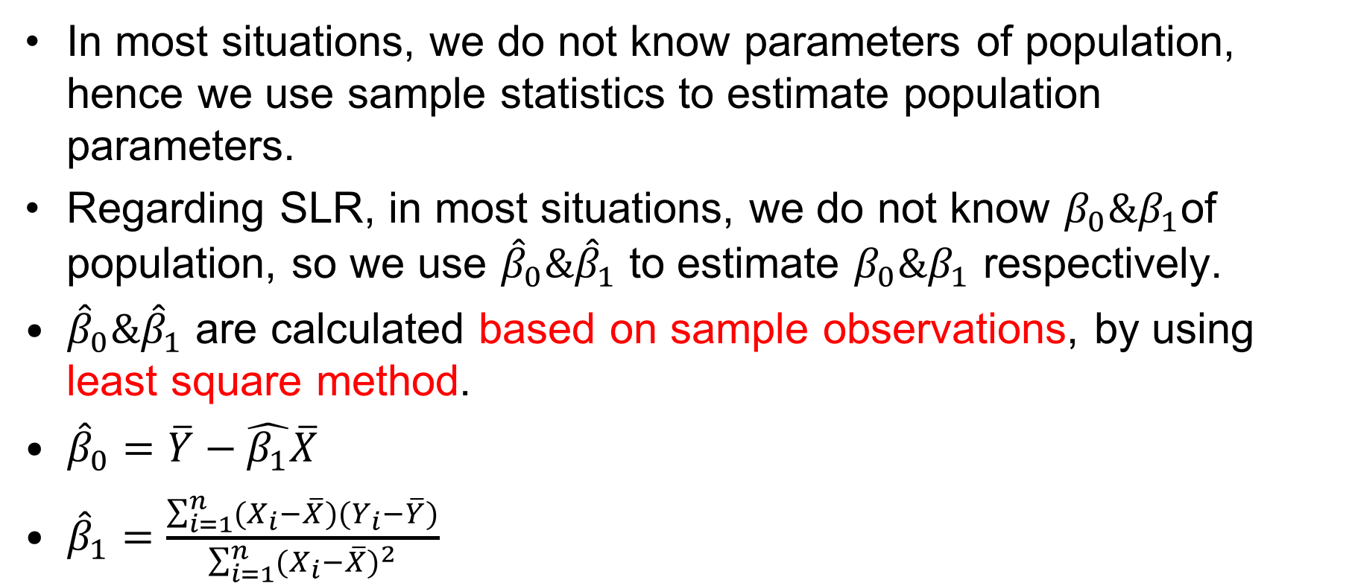
Revision – $β_{0}\&β_{1}$
In most situations, we do not know parameters of population, hence we use sample statistics to estimate population parameters.
Regarding SLR, in most situations, we do not know $β_{0}\&β_{1}$of population, so we use ${\hat{β}}_{0}\&{\hat{β}}_{1}$ to estimate $β_{0}\&β_{1}$ respectively.
${\hat{β}}_{0}\&{\hat{β}}_{1}$ are calculated based on sample observations, by using least square method.
${\hat{β}}_{0}=\overline{Y}−\hat{β_{1}}\overline{X}$
${\hat{β}}_{1}=\frac{\sum_{i=1}^{n}{(X_{i}−\overline{X})(Y_{i}−\overline{Y})}}{\sum_{i=1}^{n}{{(X_{i}−\overline{X})}^{2}}}$

Slide 4
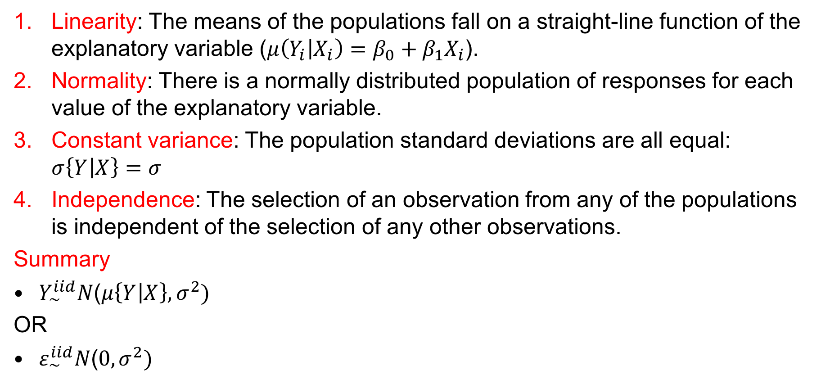
Revision – Assumptions
Linearity: The means of the populations fall on a straight-line function of the explanatory variable ($μ\left(Y_{i} | X_{i}\right)=β_{0}+β_{1}X_{i}$).
Normality: There is a normally distributed population of responses for each value of the explanatory variable.
Constant variance: The population standard deviations are all equal: $σ\left\{Y | X\right\}=σ$
Independence: The selection of an observation from any of the populations is independent of the selection of any other observations.
Summary
$Y_{∼}^{iid}N\text{(}μ\left\{Y | X\right\},σ^{2}\text{)}$
OR
$ε_{\sim }^{iid}N\text{(}0,σ^{2}\text{)}$

Slide 5
Question 1
The file “ex0727.csv” contains measured distances and recession velocities for 10 clusters of nebulae. According to a theory by Hubble the mean of the measured distance, as a function of velocity, should be β_{1*}velocity (i.e., μ(distance|velocity) = β_{1*}velocity), and β₁ is the age of the universe.
Question: Using Hubble’s theory what is the estimated age of the universe? (Hint: The R function lm() includes an intercept by default. lm(Y~X-1) fits the SLR without an intercept, i.e., μ(Y|X)= β₁X.

Slide 6
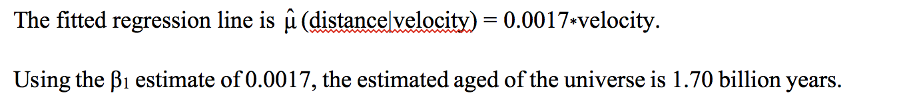
Answer

Slide 7
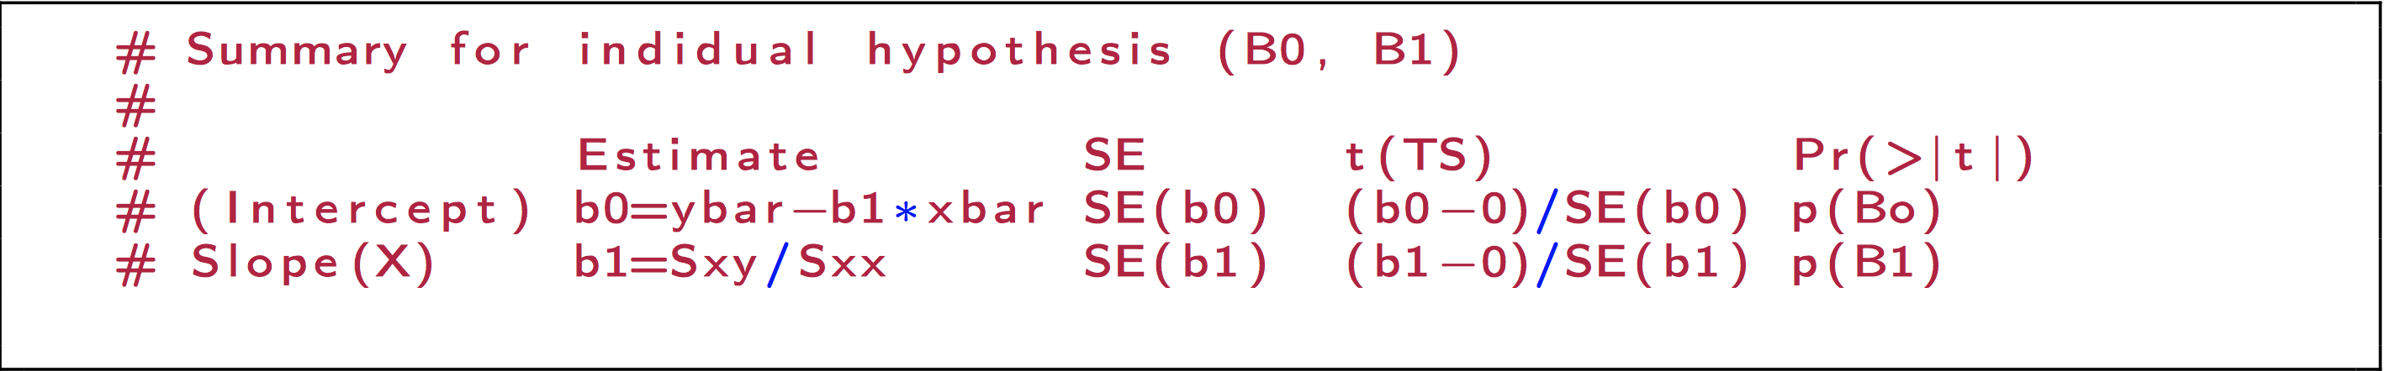
Summary Table

Slide 8
Question 2
Black wheatears are small birds of Spain and Morocco. Males of the species demonstrate an exaggerated sexual display by carrying many heavy stones to nesting cavities. Different males carry somewhat different sized stones, prompting a study of whether larger stones may be a signal of higher health status. A study was conducted (M. Soler et al.) which calculated the average stone mass (g) carried by each of 21 male wheatears, along with T-cell response measurements reflecting their immune systems’ strengths. The file “ex0729.csv” contains the data.
Question: For wheatears that carry stones with an average mass of 2g, what would you estimate their mean T-cell response to be? Comment on this estimate.

Slide 9
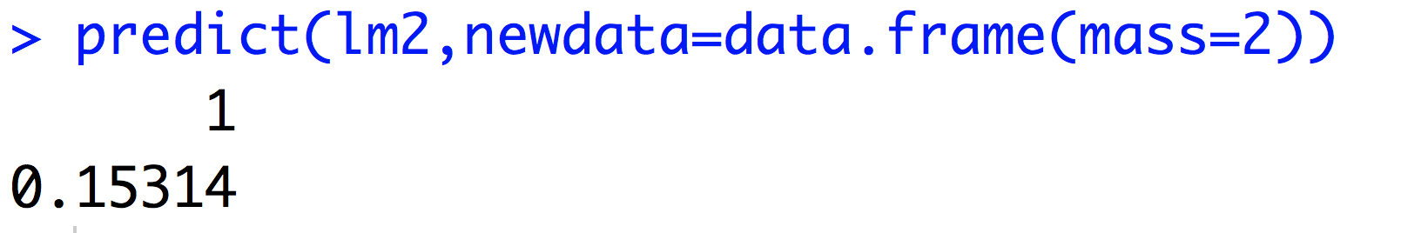
Answer

Slide 10
Extrapolation
The minimum explanatory variable value in our sample is 3.33. It is dangerous to make statements outside of the range of our explanatory variable (extrapolation). The straight line model is not necessarily valid over a wider range of explanatory variable values.

Slide 11
Question 3
One of the most dangerous contaminants deposited over European countries following the Chernobyl accident of April 1987 was radioactive cesium. To study cesium transfer from contaminated soil to plants, researchers collected soil samples and samples of mushroom mycelia from 17 wooded locations in Umbria, Central Italy from August 1986 to November 1989. Measured concentrations of cesium (Bq/Kg) in the soil and in the mushrooms are contained in the file “ex0818.csv”.
(a) Construct a scatterplot of Y = concentration in mushrooms and X = concentration in soil. What do you notice?
(b) Fit a simple linear regression using Y = concentration in mushrooms and X = concentration in soil. Produce a plot of the fitted regression line superimposed on the scatterplot of points.
(c) Repeat part (b) with point 17 removed. What do you notice?

Slide 12
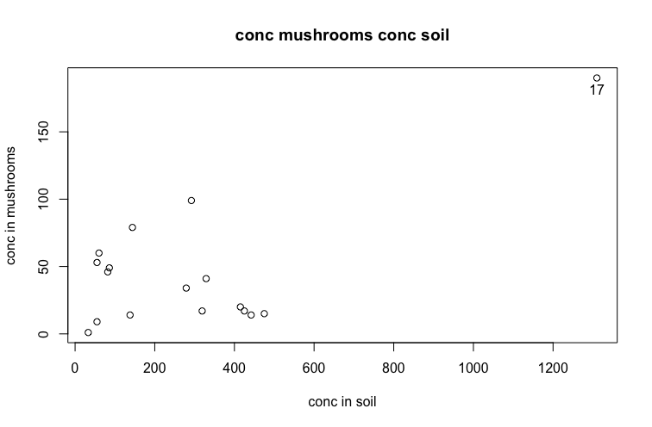
Q3 (a)

Slide 13
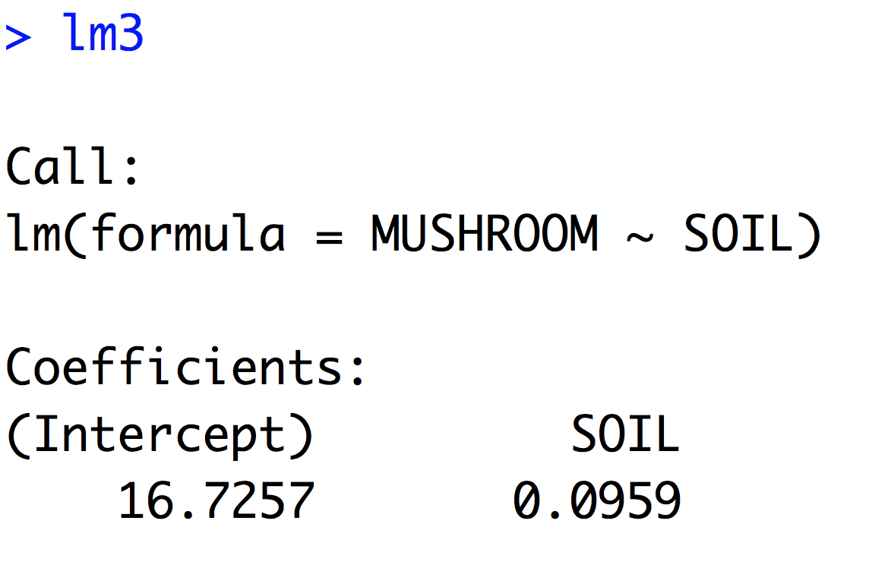
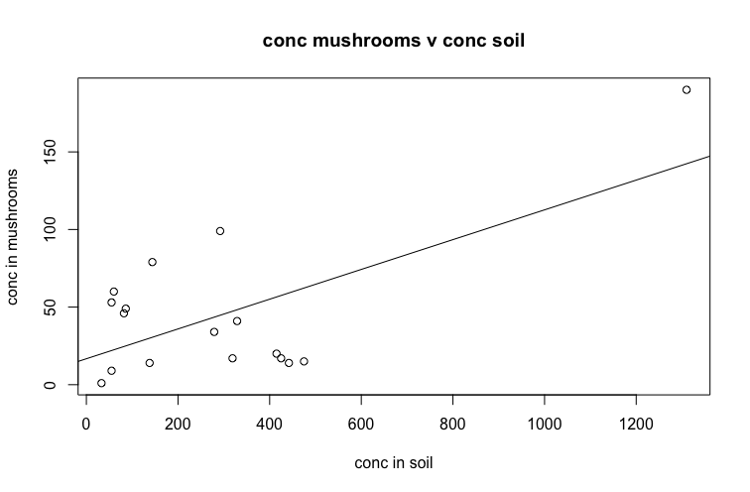
Q3 (b)

Slide 14
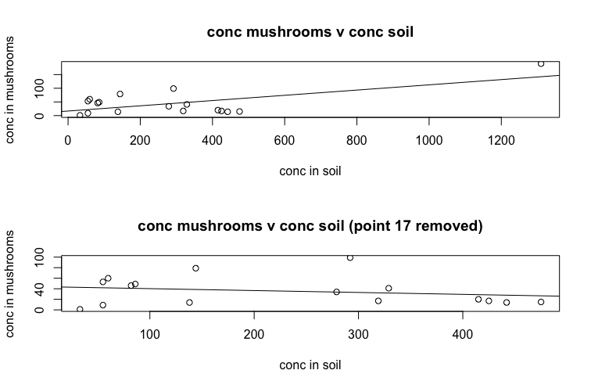
Q3 (c)

Slide 15
Q3 (c) continued
The regression is highly sensitive to point 17. The fitted regression line changes dramatically according to whether point 17 is excluded or included. Point 17 is said to be highly influential. In this example it is probably better to superimpose the regression line with point 17 removed on the original plot.

Slide 18
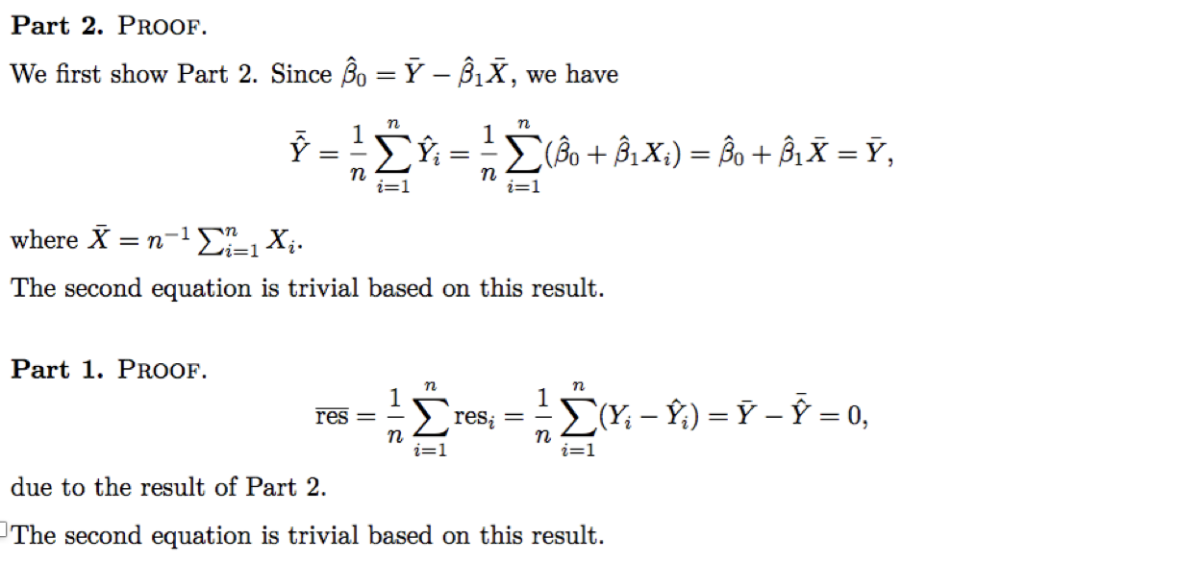
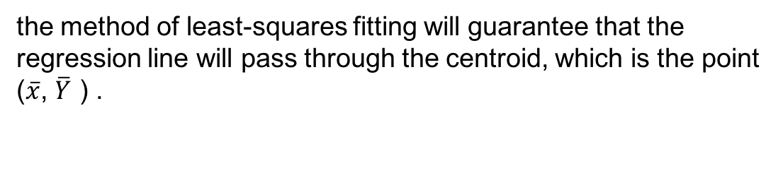
Q 4
the method of least-squares fitting will guarantee that the regression line will pass through the centroid, which is the point ($\overline{x}$, $\overline{Y}$ ) .

Slide 19
Thank you~~

